Slide 1
DATAPHONE COMMUNICATION ltd.
AMI SHARAABI
ADAM MARGALIT
GAL ETZION

Slide 2
Team
Adam
Lead Data Analyst
Ami Lead Cloud Architect
Gal CEO

Slide 3

Customers Churn
Like every other media company, our company facing the customer churn problem.
In this presentation we will try to understand the reasons for the customer’s churn. Our model will try to predict which kind of them are leaving, based on a dataset of 7,043 observes.

Slide 4

Churn
Topic One - The Problem
Topic Two – ML Algo’s
Topic Three- Conclusions

Slide 5
The Problem
Topic One

Slide 6
The Problem
Nobody Likes Churn
Towards Data Driven Solutions
Our aim is to find out what the leading causes are for churn in our company and minimize them.
We used data gathered over the span of 7+ years, covering basic demographics and in- depth membership details of our customers.
All a part of Our initiative to utilize modern technology and tools in leading company decisions.
Use of Our Machine Learning capabilities to see if we can build a model that predicts churn with a high degree of success
Ultimately, when we process new customers, we could alter contracts/ provide incentives based on churn likelihood

Slide 7

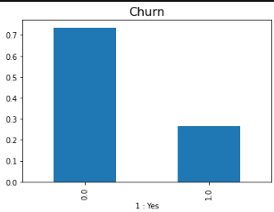

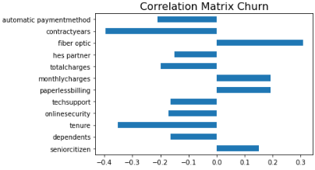

The Data
Dataset was analyzed to predict Churn
5600 individual customers were used to train the model, while the remaining 1443 customers were used to test the predictive power of the model.
Dataset involved 20 features, some of which were redundant.
Empty values in ‘Total Charge’, will ensure dataset sets empty values to null

Slide 8
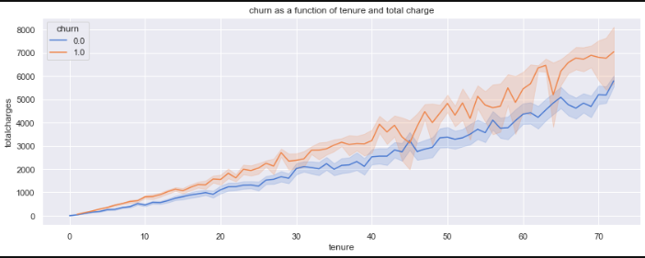
Making Sense Of The Data- what happens over time
Clear difference in total charge that impacted whether customers stayed or left. 1- Churn, 2-No Churn

Slide 9
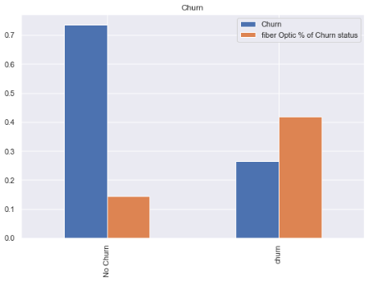
Churn and Fiber Optics
Those with fiber optic connection account for over 40% of churn rates
While only accounting for 15% of those who stay with the company
May have to do with competitors offering higher bandwidth on identical fiber optic foundations

Slide 10


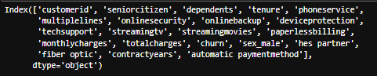
Data Engineering
We removed features and created new ones after initial preparation of the data
Missing values at the ‘total charge’ feature we replaced with ‘0’ as we suspect these have to do with payment issues and refunds.

Slide 11
ML Algo’s
Topic Two

Slide 12


ML Algo’s
We decided to code a loop that determines the ideal k-values/max depth values on each algorithm
We still ran three different values to double check
Random Forest Yielded Highest Accuracy

Slide 13
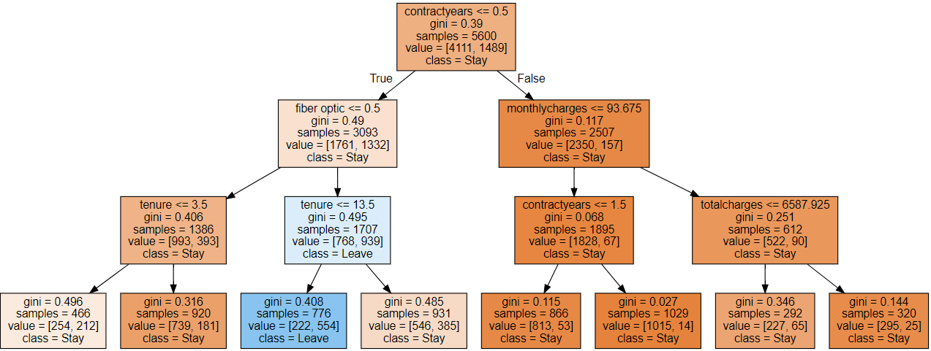
Decision Tree Data
Fiber Optic, Monthly/Total Charges, Contract Years and Tenure showed highest degree of importance in contributing predictive power to the model

Slide 14
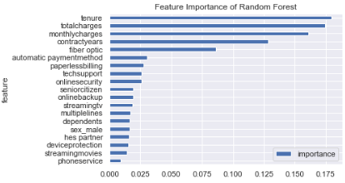
Random forest feature importance

Slide 15
Conclusion
Topic Three

Slide 16
Conclusions
Highest Accuracy
Factors That Made an Impact
Recommendations
RandomForest Algo Yielded Highest Test Accuracy : 79.6%
KNN came in second with 78% Accuracy
DecisionTree took last place with 77% Accuracy
Contract Type: Month to Month, Year, 2 Years. Month to Month Highest Churn Rate
Tenure: Churn Rate Decreases as Tenure Increases
Those With Fiber Optic Connection and those with High Total Charges tended to Churn More
Advise Customers to Change plan to Yearly Contract from Monthly Contract, Provide Discount.
Ensure Fibre Optic Speed is as Fast as Top Competitors. May lower Churn.
Inform Customers regularly on the accumulating charge, to ‘soften the blow’ when payment is due.

Slide 17




Thank you

